Slide 1
Learning Out Loud
My Ongoing DF/IR Challenge
Works and thoughts are solely my own and not that of my employer

Slide 2
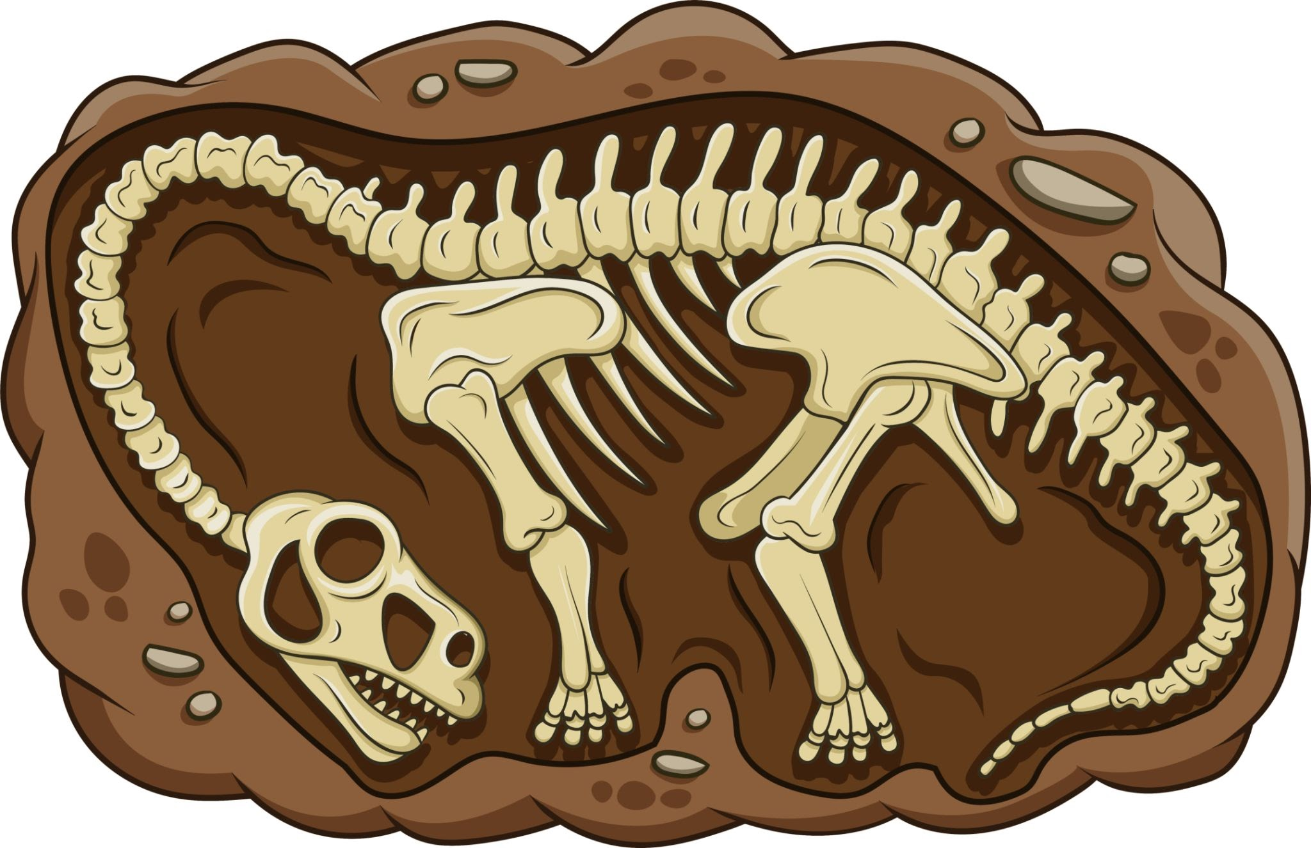

Shoutouts
Thanks to the Founders, Organizers, Sponsors, and Volunteers that made BSides South Jersey happen.
My family who have dealt with my many late nights. Currently digging up fossils at Edelman Fossil Park and Museum.

Slide 3
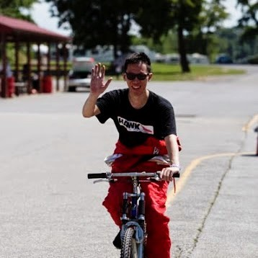
Christopher Eng
Independent Digital Forensic Researcher
20 years of IT experience
Support
System Administration
Software Development
Former CIO
Cybersecurity
Cybersecurity Lead at a nonprofit

Slide 4
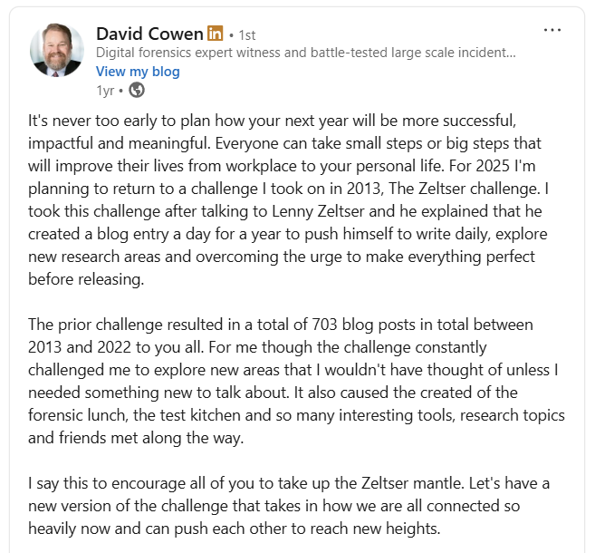
Zeltser Challenge
Started in 2025
Daily posts
Push to explore interests
Research new areas
Embrace imperfection
Network

Slide 5

Logistics
Pick a platform or platforms
LinkedIn, GitHub Pages, Medium, etc
Have some fun
Fun name, Logo

Slide 6
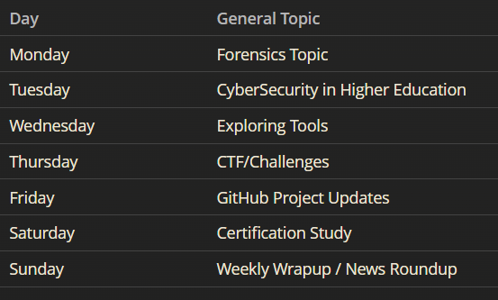
The Plan
Have a plan but be ready to throw it away

Slide 7
Reality
What actually happened
Lasted a month or so
This is a challenge for me. I can do whatever I want.
Just post!

Slide 8

Wandering
“Not all those who wander are lost” - J.R.R Tolkien
Explore new areas
Push your boundaries
Fail
Hit dead ends
This journey is for you
Likes and reposts don’t matter

Slide 9
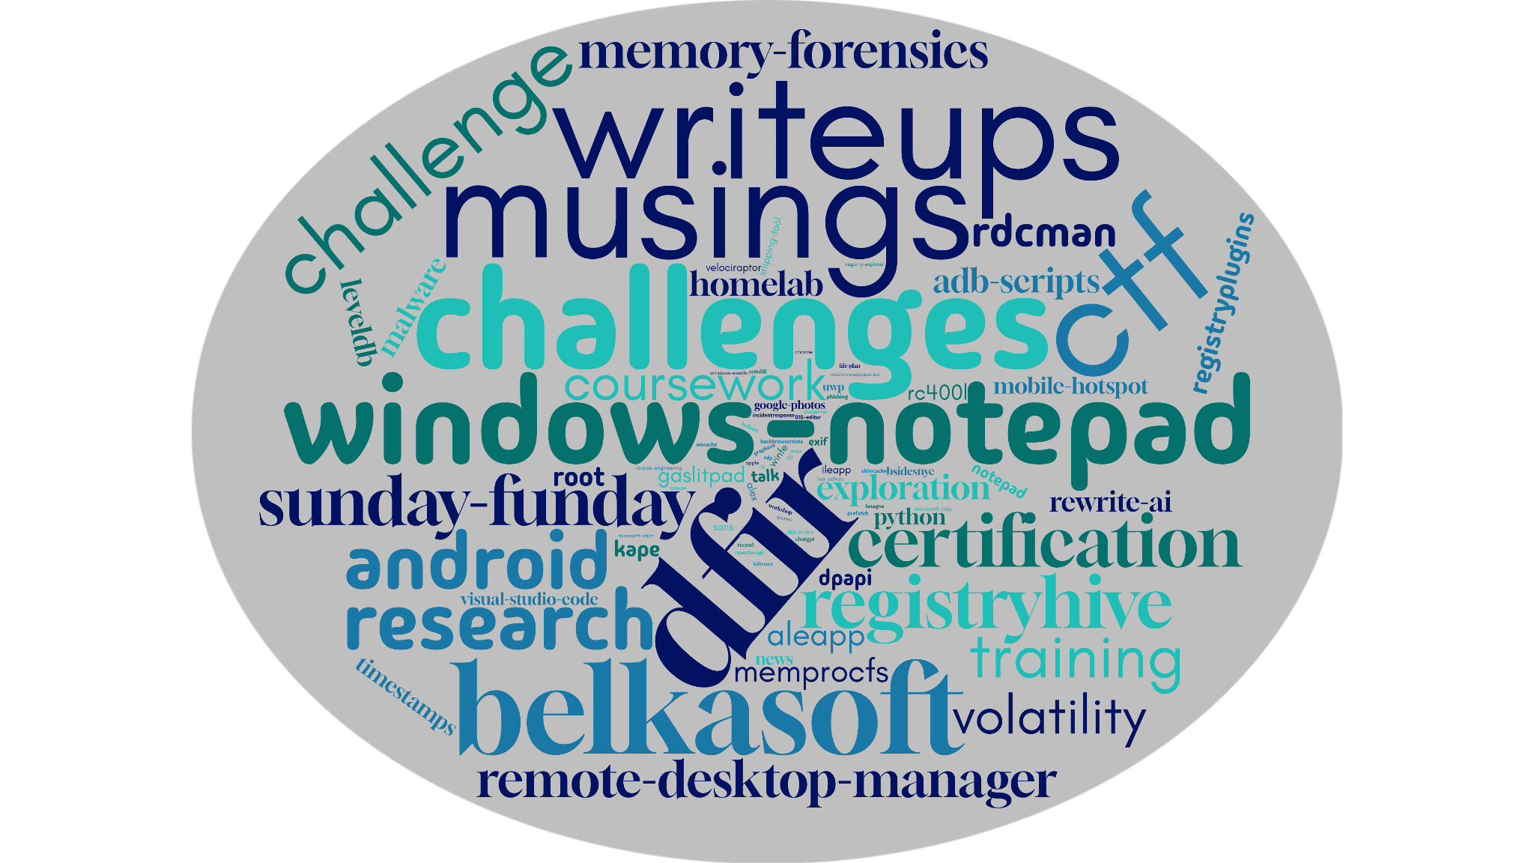
My Journey

Slide 10

Short Detours
There are no dead ends or failures. You can always revisit in the future.
LevelDB
More time needed than I wanted to devote
Orbic RC-400L Hotspot Forensics
Nothing grabbed my interest

Slide 11
Day Trips
Read something interesting?
Apply it
Post your findings / Add your spin
Android Logical Extractor (ALEX) - Christian Peter
Application Registry Hives - Chris Ray
WinFE

Slide 12

Long Journeys
Discover something you’re interested in and pursue it.
Windows Notepad
Contributing to DF/IR Projects

Slide 13
Destinations
Your long journeys can result in research papers and other contributions.
DFIR Review - Peer Review
KAPE Targets/Modules
ALEAPP Plugins
Velociraptor

Slide 14

Get Lost
Don’t be afraid to get lost and visit new places and learn new things
Memory Forensics
MemProcFS
Volatility
Android Forensics
ALEAPP
Velociraptor

Slide 15
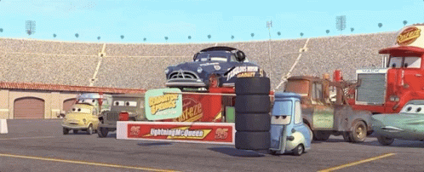
Regular Pitstops
Keep your momentum going with straightforward topics
Monthly/Weekly recaps
Training
CTFs/Challenges

Slide 16
Training/Coursework
Provide your own impressions and takeaways. These can serve as reminders and notes for future you.
Degree coursework
Certification studies

Slide 17
CTFs/Challenges
It is easy to mechanically write out the solution. Plenty of those exist. Talk about your approach/thinking/dead ends.
Magnet
Belkasoft
SANS
etc

Slide 18

Sunday Funday
Challenges posed by David Cowen
Short, targeted topics to research
You could create your own “Sunday Funday” challenges and invite others to join.

Slide 19
Your Turn
Make a plan that you don’t have to follow
Let your curiosity guide you and take detours
Pick something and take that long journey
Don’t be afraid to get lost
Just Post
Enjoy the Journey!

Slide 20

Thanks!
Slidedeck and information available at: https://ogmini.github.io/talks
Works and thoughts are solely my own and not that of my employer

